Slide 1

Name of the School: School of Computer Science and Engineering
Course Code: E1UA307C Course Name: JAVA PROGRAMMING
ONLINE BANKING MANAGEMENT SYSTEM
PRESENTED BY:-
Satyam Kumar (23SCSE1012024)
Abhijeet Sah (23SCSE1010152)
Prashant Kumar (23SCSE1010486)
Shivam Shukla (23SCSE101444)
Section:-6
GUIDED BY:-
SHIVANGI SINGH

Slide 2
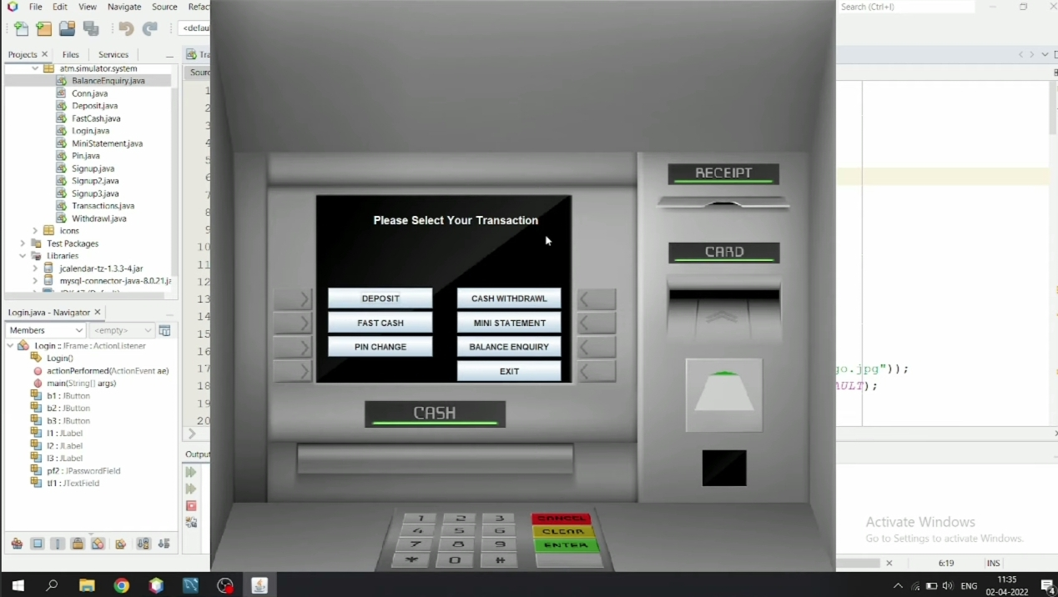
Name of the School: School of Computer Science and Engineering
Course Code: E1UA307C Course Name: JAVA PROGRAMMING
Problem Statement
The system will allow customers to view and manage their bank accounts, perform transactions, and access various banking services. Administrators will handle user management, transaction monitoring, and system settings.

Slide 3
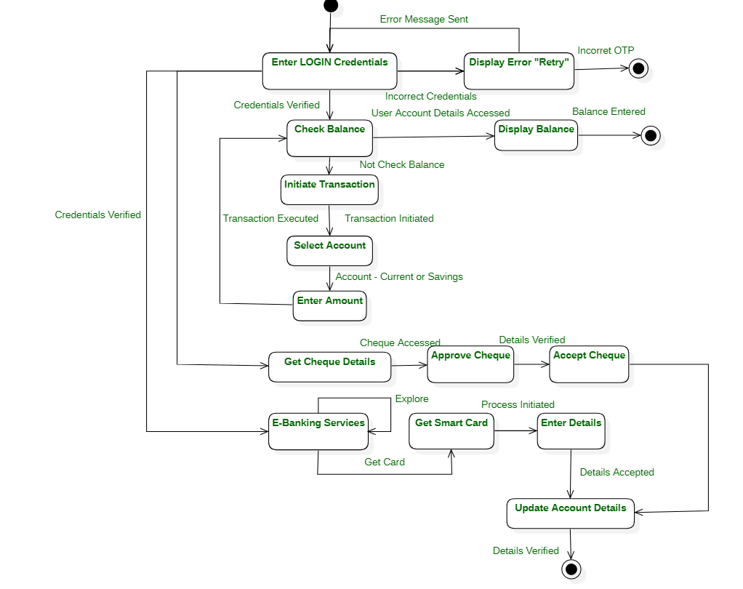
Name of the School: School of Computer Science and Engineering
Course Code: E1UA307C Course Name: JAVA PROGRAMMING
Flowchart

Slide 4
Name of the School: School of Computer Science and Engineering
Course Code: E1UA307C Course Name: JAVA PROGRAMMING
Technical stacks
Frontend: HTML, CSS, JavaScript.
Version Control: Git and GitHub.
Backend: Java for server-side processing.
Database: MySQL for data storage.

Slide 5
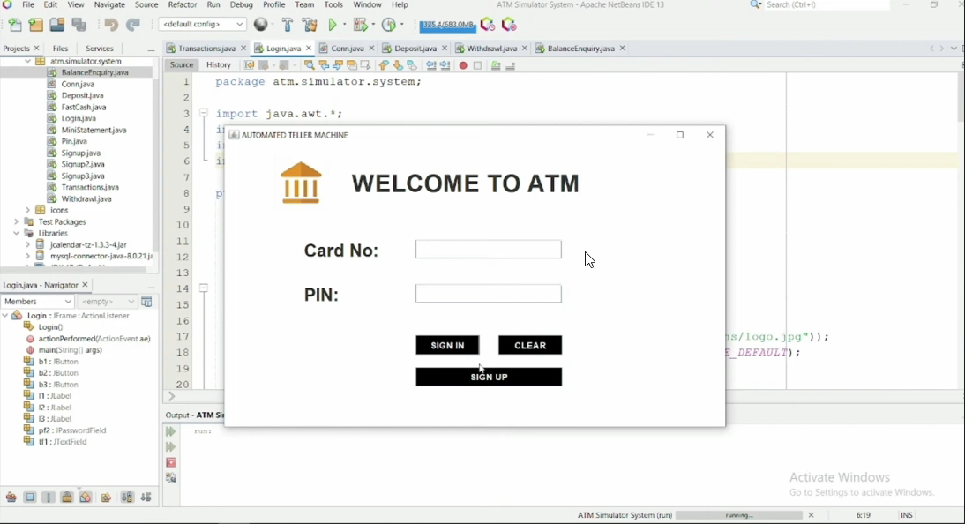
Name of the School: School of Computer Science and Engineering
Course Code: E1UA307C Course Name: JAVA PROGRAMMING
Results:-

Slide 6
Name of the School: School of Computer Science and Engineering
Course Code: E1UA307C Course Name: JAVA PROGRAMMING
Conclusion
The Online Banking Management System was created to make banking easier and more secure for users. It allows customers to perform important tasks like checking account balances, transferring money, and viewing transaction history, all from the comfort of their homes.
The system was designed with strong security measures to protect users’ personal information and money. It is easy to use, offering a smooth and reliable experience for customers.
In conclusion, the system helps banks operate more efficiently while providing better service to their customers. In the future, it could be improved by adding features like AI for detecting fraud and making the system more accessible on mobile devices.

Slide 7

Name of the School: School of Computer Science and Engineering
Course Code: E1UA307C Course Name: JAVA PROGRAMMING
THANKYOU

